Slide 1

Perplexing
Image Recognition Systems
Using
Mutation Generative Adversarial Networks
ROHAN ACHARYA
Notes:
Hi everyone. My name is Rohan Acharya and I’m here you alert you about a grim possibility.

Slide 2
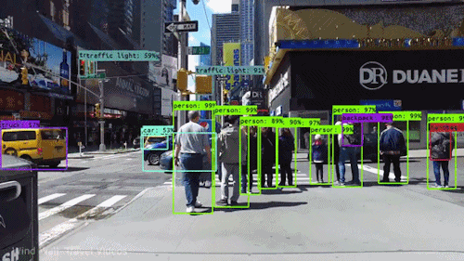
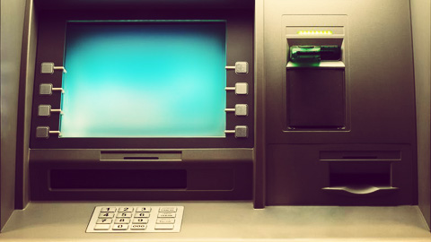
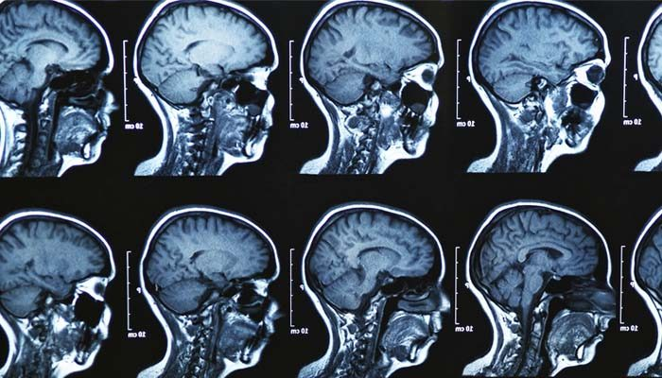

Background
AI is becoming a pervasive and disruptive force
Safety-critical applications rely on deep learning for image classification
Self-driving Cars
Facial-recognition ATMs
Medical Imaging Systems
Notes:
Most of you will agree when I say that AI is becoming an increasingly pervasive and disruptive force, controlling many aspects of our everyday lives, from transportation to medicine. In fact, as of November 2019, 30 U.S. states allow autonomous cars to be deployed on public roads.
These applications have been made possible by what is known as deep learning, a class of machine learning algorithms that use multiple layers to progressively extract higher level features from raw input, making them ideal for image classification.
But

Slide 3
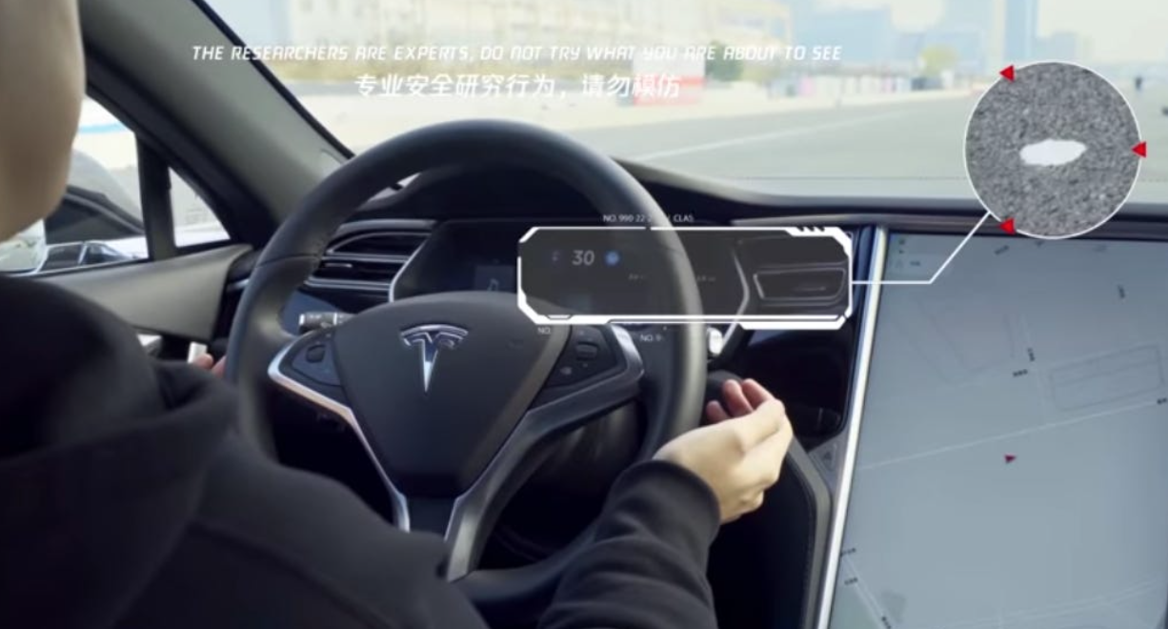
What if an AI is hacked?
What if an AI is hacked?
What if an AI is hacked? What if an AI goes rogue?
April 2019: Keen Security Lab researchers trick a Tesla Model S in Autopilot mode to swerve towards oncoming traffic
Notes:
What if an AI is hacked? What if an AI goes rogue?
These are not dialogues from the next best sci-fi movie but are questions that must be addressed before deploying AI.
[Hit Enter]
Just last year, researchers at Keen Security Lab were able to trick a Tesla Model S into swerving towards oncoming traffic by placing three stickers on the ground and confusing its Autopilot software. Imagine how easy it would be for hackers to wreak havoc!
Today, I will describe a novel architecture that can be exploited by adversaries to hack into safety-critical image recognition systems. But before I do that, I’m going to go over some previous relevant research.

Slide 4

Review of Literature Problem & Hypothesis Methods & Materials Results & Analysis Conclusion Future Steps Acknowledgements
Image Recognition Systems
Convolutional Neural Networks (CNNs)^{[LeCun, 1998]}
Notes:
Image recognition systems aka image classification systems rely on a machine learning model known as a CNN, which stands for convolutional neural network. Their primary task is to take an input image and output a class or probability of classes that best describe the image. While this may be a trivial task for humans, it is much more difficult for computers to do this.
A CNN does this by looking at low level features such as edges and curves, and then, building up to more abstract concepts through a series of convolutional layers. Even though this is a very complex task, CNNs are extremely effective at image classification.

Slide 5
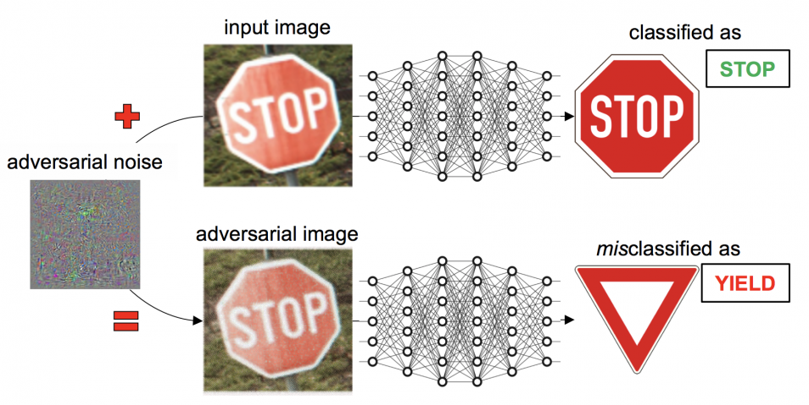
Review of Literature Problem & Hypothesis Methods & Materials Results & Analysis Conclusion Future Steps Acknowledgements
Adversarial Machine Learning^{[Szegedy, 2014]}
Fooling machine learning models using “adversarial samples” or intentionally perturbed inputs
Notes:
While CNNs are effective under most circumstances, there are exceptions … [pause]
The field of adversarial machine learning involves fooling machine learning models, such as CNNs, using intentionally perturbed inputs also known as adversarial samples.
As you can see in the diagram, when the image of a normal stop sign is fed into a CNN, it is correctly classified. However, when you add a trained-for adversarial noise, the resulting adversarial image is then misclassified as a yield sign.
To a human, the input image and the adversarial image may look nearly identical, but this is not the case for machine learning models. The security community recognizes that adversarial samples are a serious threat to critical image recognition systems, and much research is being done on how to effectively detect and neutralize them.

Slide 6
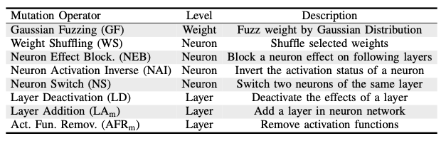
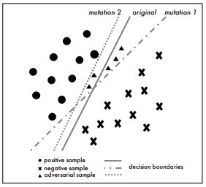
Review of Literature Problem & Hypothesis Methods & Materials Results & Analysis Conclusion Future Steps Acknowledgements
Model Mutation Testing^{[Wang, 2018]}
Detect adversarial samples through the generation of mutant CNNs obtained by applying mutation operators^{[Ma, 2018]}
Label Change Rate (LCR)
Measures how sensitive an input sample is to mutations imposed on the
target model (should be larger for adversarial samples)
Notes:
A recent approach suggests the use of mutant models to detect adversarial samples at runtime. This approach takes advantage of the fact that adversarial samples are created with the intent of fooling a particular target model and are therefore, sensitive to small changes in the target model’s parameters. These mutant models are created by applying a variety of mutation operators to the original model, as shown in the table below.
In order to measure the sensitivity of inputs to these mutations, we can calculate the label change rate. The label change rate, or LCR, is simply the percentage of samples that are classified differently by the target model after a mutation is applied.
The label change rate of adversarial samples has been shown to be significantly larger than that of normal samples, and therefore, a simple hypothesis test using a threshold label change rate would allow us to flag an input as an adversarial sample or as safe.
This diagram illustrates the model mutation testing effect. As we randomly mutate the model and perturb the decision boundary, adversarial samples are more likely to cross the mutated decision boundaries, and would therefore have a higher label change rate.

Slide 7
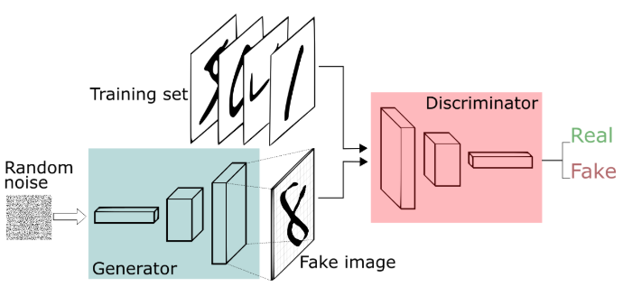
Review of Literature Problem & Hypothesis Methods & Materials Results & Analysis Conclusion Future Steps Acknowledgements
Generative Adversarial Networks (GANs)^{[Goodfellow, 2014]}
Machine learning model used for image generation
Two-party architecture
Generator
Discriminator
Notes:
So while CNN’s are used for image classification, Generative Adversarial networks, or GANs, are used for image generation. GANs have a two-party architecture, with a generator and a discriminator. The generator takes in random noise and attempts to map it to the data distribution from the training set. In other words, it attempts to generate images that are similar to the training images. The discriminator then outputs the probability that the generated image comes from the training data and not from the generator, or in other words, the chance that it is real. The GAN trains using a min-max objective where the discriminator aims to maximize the probability that it identifies labels correctly and the generator is able to fool the discriminator. This should result in a confused discriminator and a generator that can generate realistic images.

Slide 8
Review of Literature Problem & Hypothesis Methods & Materials Results & Analysis Conclusion Future Steps Acknowledgements
State-of-the-Art Defense Mechanisms
Detect adversarial samples by taking advantage of their sensitivity to random mutations imposed on the target model
Gap: Current adversarial sample generation methods yield samples that are easily detected, giving a false sense of security!
Mutation Generative Adversarial Network (MGAN)
Possible to generate more robust adversarial samples i.e. malicious inputs will be misclassified as safe
Statement of Purpose: Improve the security of safety-critical image recognition systems by exposing this vulnerability
Notes:
As I mentioned before, state-of-the-art defense mechanisms are able to detect adversarial samples by taking advantage of their sensitivity to random mutations imposed on the target CNN model.
However, there remains a gap.
Current adversarial sample generation methods yield samples that are easily detected, giving us a false sense of security.
In my research, I propose a novel framework called a Mutation Generative Adversarial Network, or MGAN, which makes it possible to generate more robust adversarial samples that are undetectable by model mutation testing.
The goal of my research was to alert security researchers of this vulnerability, so they can patch CNN’s and make them secure.

Slide 9
Hypothesis
Review of Literature Problem & Hypothesis Methods & Materials Results & Analysis Conclusion Future Steps Acknowledgements
By wiring mutants as a third component in the original two-party architecture of GANs, we can guide the generation of mutation-consistent yet effective adversarial samples
Notes:
My hypothesis was that by wiring mutants as a third component in the original two-party architecture of GANs, we can guide the generation of mutation-consistent yet accurate adversarial samples. And what I mean by mutation consistent, is that they will not be sensitive to random mutations imposed on the target model. In a few slides, I will explain how we can achieve this.

Slide 10
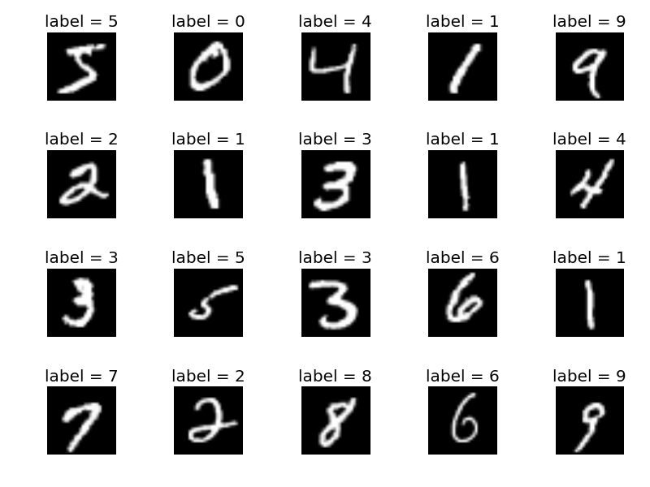
Data
Review of Literature Problem & Hypothesis Methods & Materials Results & Analysis Conclusion Future Steps Acknowledgements
MNIST Dataset^{[LeCun]}
Handwritten digits from 0-9
Training set of 60,000 samples
Test set of 10,000 samples
Notes:
I used the MNIST dataset, which is considered the standard for machine learning. It consists of handwritten numerical digits from 0-9, and the training data contained 60000 images while the testing set contained 10000 images.

Slide 11
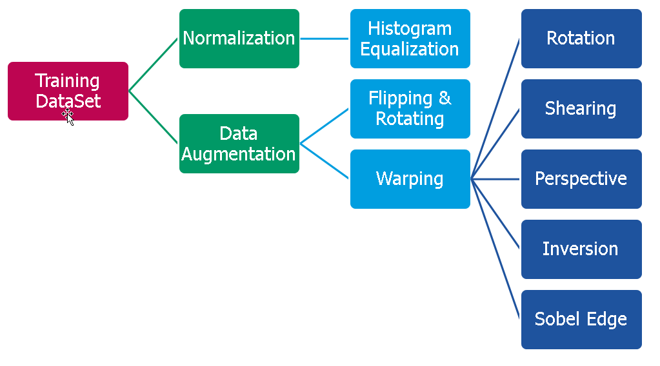
Data Preprocessing
Review of Literature Problem & Hypothesis Methods & Materials Results & Analysis Conclusion Future Steps Acknowledgements
Insensitive to magnitude
Faster convergence
Prevents overfitting
More diverse adversarial samples
Notes:
In order to preprocess my data, I performed normalization and data augmentation.
Normalization is used to change the range of pixel intensity values, which makes the CNN model that will eventually be trained insensitive to small changes in magnitude and also leads to faster convergence during training.
Data augmentation, on the other hand, is used to prevent overfitting of the CNN model, which is when the CNN memorizes the training data and is unable to generalize beyond it. It involves transformations, such as random rotations, inversions, and crops of the images. And more specific to what I am trying to do, this will help result in more diverse adversarial samples and allow us to cover more modes of the data.

Slide 12
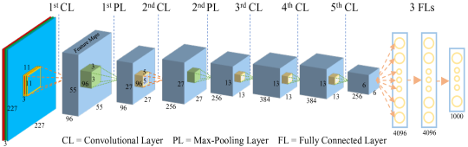
Training the Target Model
Review of Literature Problem & Hypothesis Methods & Materials Results & Analysis Conclusion Future Steps Acknowledgements
Implemented using PyTorch, a Python-based machine learning library
Trained on PC with RTX 2080-Ti and Intel i-9 9900k
99.1% accuracy on testing set
Notes:
I implemented the CNN using Pytorch, a Python based machine learning library and trained it using a PC with an RTX 2080TI GPU and an Intel i9 9900k cpu. The model ended up achieving an accuracy of 99.1% on the testing data, so it was pretty good. Here you can see the architecture of the CNN, which consisted of 5 convolution layers, with the first 2 followed by max-pooling layers and then 3 fully connected layers. All of these layers are used to reduce the spatial size of the convolved feature in order to reduce the amount of computational power needed.

Slide 13
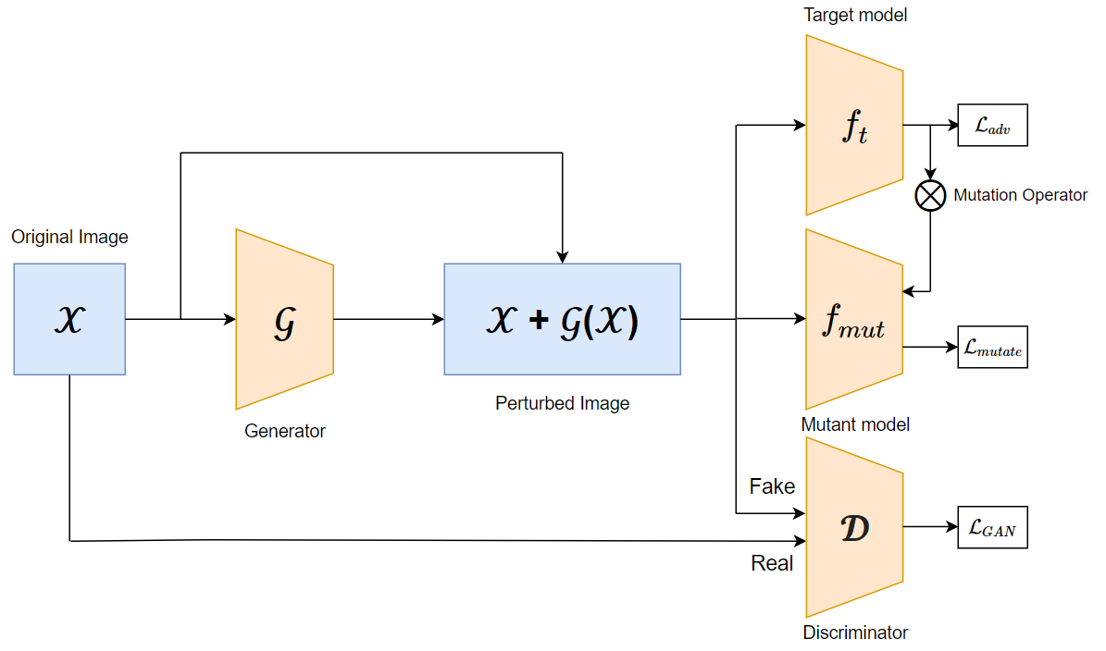
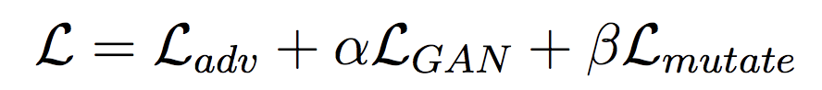
Review of Literature Problem & Hypothesis Methods & Materials Results & Analysis Conclusion Future Steps Acknowledgements
MGAN Architecture
Final objective: Minimize
Notes:
Here is the architecture of MGAN. The image is first fed into the generator, which produces a perturbation. The perturbed image is then fed into 3 models.
It is first fed into the discriminator, which outputs the probability that the adversarial sample is real and produces the GAN loss. Then, it is fed into the target model, which produces an adversarial loss representing the adversarial sample’s ability to fool the target model. Lastly, it is fed into a mutant model, which produces a mutant loss representing the difference in the outputs of the target and mutant models.
We can then define our final objective as minimizing the sum of the adversarial, GAN, and mutant losses, where alpha and beta can be adjusted to tradeoff between quality and robustness. A high value for alpha would prioritize how realistic the image is and a high value for beta would prioritize robustness and keeping a low label change rate.

Slide 14
Evaluation Criteria
Review of Literature Problem & Hypothesis Methods & Materials Results & Analysis Conclusion Future Steps Acknowledgements
Compared the results of MGAN and AdvGAN (state-of-the-art)^{[Xiao, 2018]}
Measured:
Accuracy: the misclassification rate of the adversarial samples
Label Change Rate: percentage of adversarial samples that are classified differently by the target model after a mutation is applied
Notes:
In order to evaluate MGAN, I compared its results to those of AdvGAN, which is considered as state of the art when it comes to adversarial sample generation. I measured the accuracy, or misclassification rate, as well as the label change rate, which again is the percentage of adversarial samples that are classified differently by the target model after a mutation is applied, and measures how robust the adversarial samples are.

Slide 15
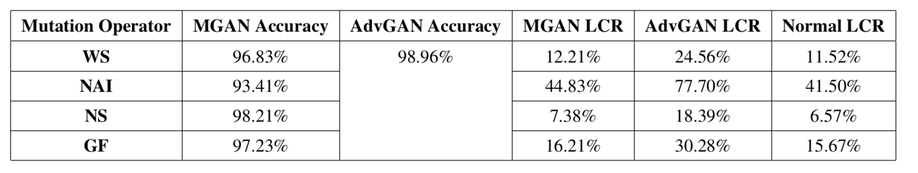
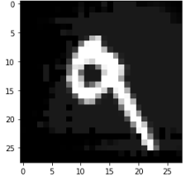
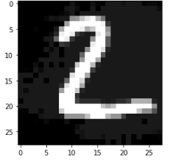
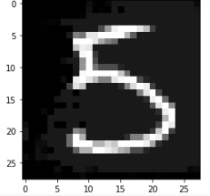
Review of Literature Problem & Hypothesis Methods & Materials Results & Analysis Conclusion Future Steps Acknowledgements
Comparable
Indistinguishable
Much better than AdvGAN
classified as a 3
classified as a 0
classified as a 6
Notes:
In the results table, we can see that MGAN’s accuracy was very comparable to that of AdvGAN. AdvGAN had an accuracy of 98.96%, and MGAN’s accuracy was only worse by just a few points.
However, on the right side of the table, we can see that label change rate of MGAN’s samples was nearly indistinguishable from that of normal samples. However, the label change rate of AdvGAN’s samples was much higher and they would be easily detectable via model mutation testing.
Below we can see some samples generated by MGAN. Although there is a clear perturbation, the samples still look quite realistic yet remain successful and indetectable.

Slide 16
Conclusion
Review of Literature Problem & Hypothesis Methods & Materials Results & Analysis Conclusion Future Steps Acknowledgements
Hypothesis supported!
MGAN was able to produce effective and mutation-consistent adversarial samples that were undetectable by model mutation testing
Adversarial samples pose a real threat to AI security
Does this mean that we should stop deploying AI?
No!
Notes:
So in conclusion, the hypothesis was supported. MGAN was able to produce effective and mutation-consistent adversarial samples that were undetectable by model mutation testing. It was also able to generate realistic samples with minimal perturbations that were still able to fool a state-of-the-art image recognition model.
Adversarial samples pose a real threat … from fooling autonomous cars to cause casualties to fooling medical imaging systems for insurance fraud, we need to use our imagination to anticipate what hackers may come up with so we can stay one step ahead of them.
Does this mean that we should stop deploying AI? No! AI offers a tremendous upside potential, so we simply need to address security concerns and make sure that what we are deploying is secure.

Slide 17
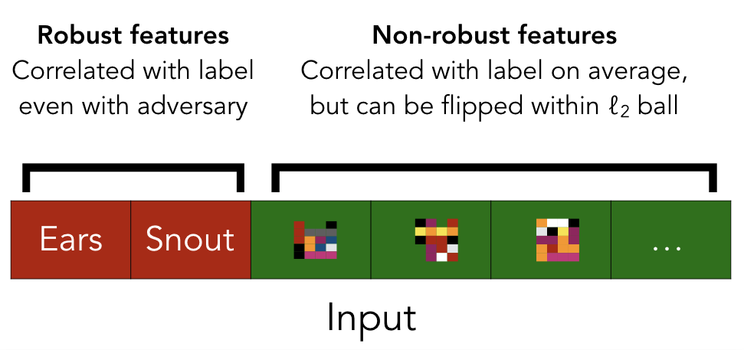
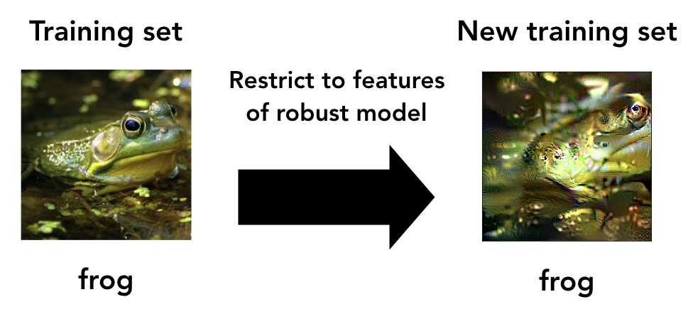
Future Steps
Review of Literature Problem & Hypothesis Methods & Materials Results & Analysis Conclusion Future Steps Acknowledgements
Focus on robust features
Notes:
So you may be wondering what researchers can do to actually patch this vulnerability...
We believe that classifiers need to start focusing on robust features. For a classifier that aims to detect a dog, this would mean identifying features such as eyes and a snout as opposed to specific patterns in the pixel values. These non-robust features are what adversarial samples take advantage of.
If we want our models to ignore them, we must introduce priors into the training process in order to steer them towards relying on robust features. This would be analogous to modifying the training set in order to restrict it to the desired features of the robust model.

Slide 18
Acknowledgements
Review of Literature Problem & Hypothesis Methods & Materials Results & Analysis Conclusion Future Steps Acknowledgements
I would like to thank my mentor for introducing me to the field of adversarial machine learning, guiding me through the initial literature search, and providing me with crucial assistance in the brainstorming phase.
I would also like to thank my science research teachers for providing me with unconditional support throughout the research process.
Notes:
Before I take your questions, I would like to thank my science research mentor for introducing me to the field of adversarial machine learning, guiding me through the initial literature search, and providing me with crucial assistance in the brainstorming phase.
I would also like to thank my science research teachers for providing me with unconditional support throughout the research process.

Slide 19
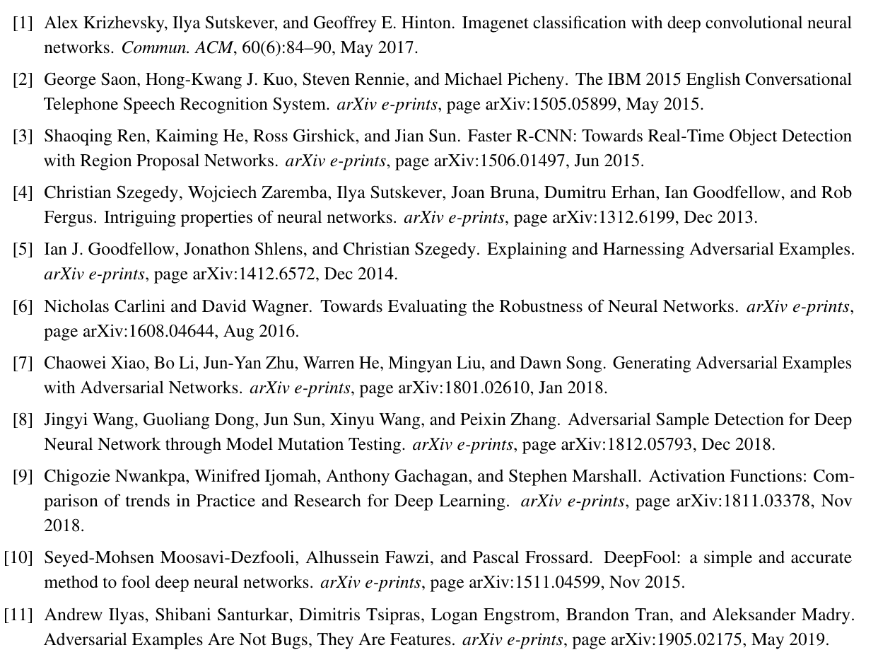
Thank you!
Questions?
Notes:
Thank you for attention, and I’d love to answer any questions you may have!
[switch to next slide and stay there]

Slide 20
Perplexing Image Recognition Systems Using Mutation Generative Adversarial Networks
Background | Review of Literature Image Recognition Systems Adversarial Machine Learning Model Mutation Testing Generative Adversarial Networks
Problem & Hypothesis AI Security Risk Hypothesis | Methods & Materials Data Data Preprocessing Training the Target Model MGAN Architecture
Conclusion | Future Steps

